Slide 1
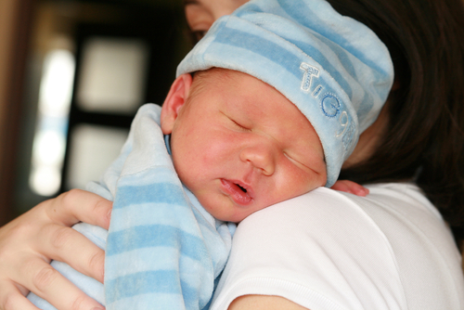

Slide 2
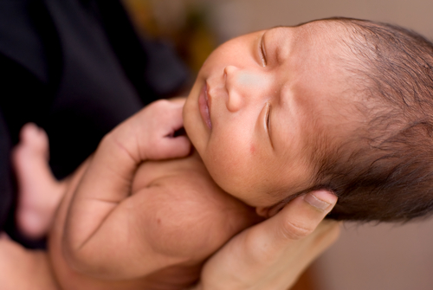

Slide 3
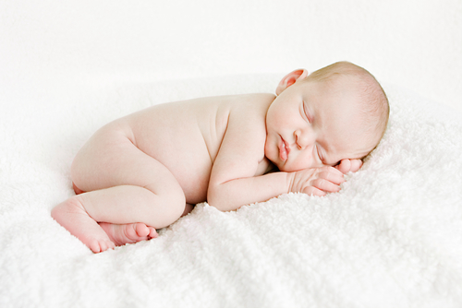

Slide 4
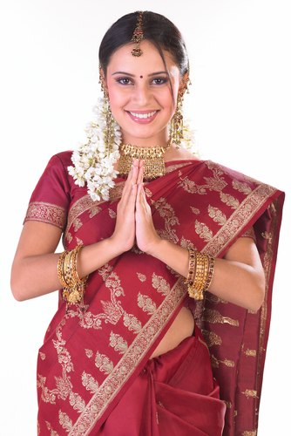

Slide 10
Describe the babies and adults
What helped you describe the babies?
Why could you describe more things in the adults?
What changes as they grow up?
What things stay the same?
Does one baby or adult deserve to be treated differently to others?

Slide 11
Diamond 9
1
2
2
3
3
3
4
4
5

