Slide 1
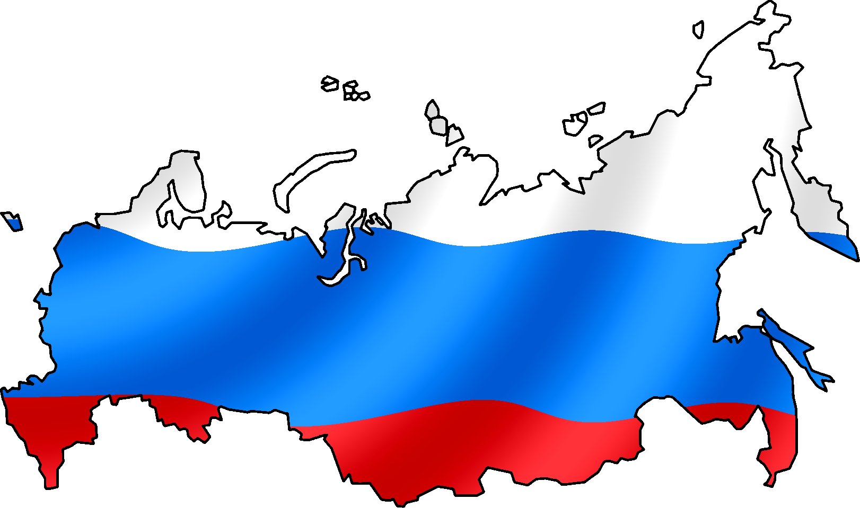
Mini Case Study: Life expectancy in Russia
Where does Russia’s economy (rank
In terms of total GDP) on a global
Scale?
Describe the trends in life expectancy for Russia from the 1960’s to the present day. (mention overall trends and specifics about male and females.
What about GDP per capita
What would you expect Russia’s life expectancy to be based on the
economic situation of the country?
Where does Russia rank in terms of
Its life expectancy?
Read the Forbes article on the Russian life expectancy drop in 2012. What do you think will happen to life expectancy in Russia in the next 5 years? (give reasons for your answers)
What are the main causes of the life expectancy issues in Russia

