Slide 1
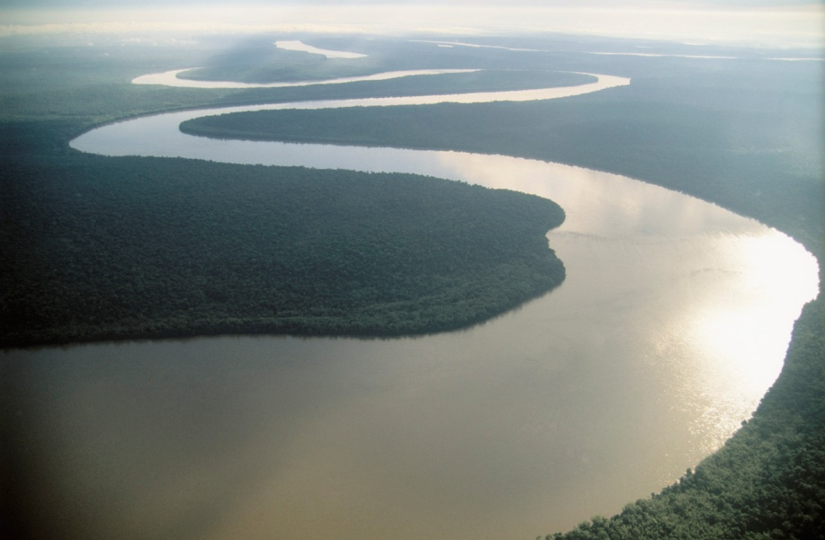
River Discharge and Flood Hydrographs
Objective: To understand the characteristics of a storm Hydrograph in order to analyse and interpret their data.

Slide 2
What is discharge?
Discharge = is the volume of water in a river, at a given place and time. It is calculated in cumecs (cubic metres per second).
Discharge = velocity x area.
Velocity = is the speed of the river (m/s)
Area = is the area of the cross section at a single point in the river (width x depth)

Slide 3
What would cause a rivers discharge to ……
Increase?
Decrease?
Heavy rainfall
Long periods of rainfall
Urban areas (land use)
Impermeable rock (does NOT let water through e.g clay, slate.)
Saturated soils
Steep gradient
Low temperatures
Surface run off
Snow melt
No/little rainfall
Trees/vegetation (intercepts and takes in water)
Permeable rocks e.g limestone, chalk.
Porous rocks
Gentle gradient
Dry soils

Slide 4
A flood/storm hydrograph
A rivers discharge can increase dramatically during and after a storm, causing flooding. It can also drop quickly after the storm has passed.
These changes can be recorded in a storm/flood hydrograph.

Slide 5
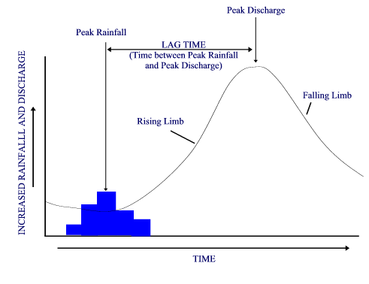
A flood/storm hydrograph

Slide 6
Rainfall shown in mm, as a bar graph
Discharge in m³/s, as a line graph
Basin lag time
Peak flow
3
Rising limb
2
Recession limb
Discharge (m³/s)
mm
4
1
3
2
0 12 24 36 48 30 72
Hours from start of rain storm

Slide 7
Key words associated with a flood hydrograph. (You need to refer to these in exam questions about hydrographs)
The normal discharge of the river
Rising limb =
Falling limb (recession) =
Lag time =
Peak Flow =
Base flow =
Maximum discharge in the river
The flood water falling
The rising flood water in the river
The time difference between the peak rainfall and the peak discharge

Slide 8
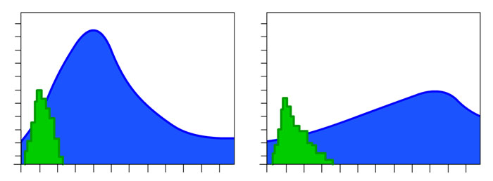
Short Lag time
Long Lag time
What affects the shape of a hydrograph?
Land use
Geology and soil
Drainage density
Gradient of the valley sides
Type and amount of precipitation

Slide 9
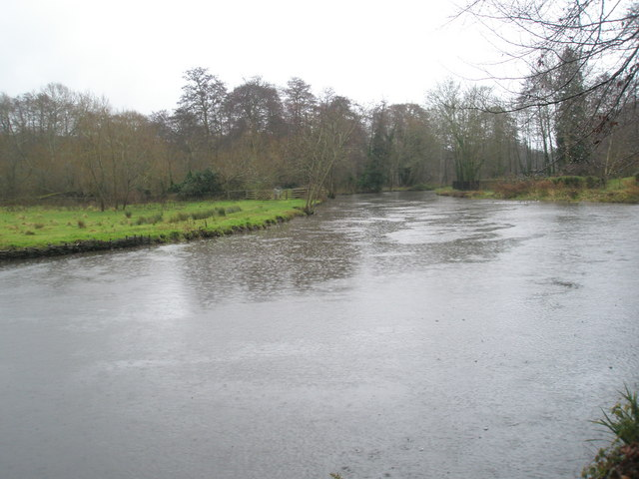
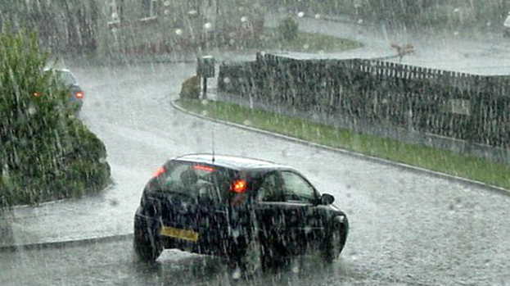
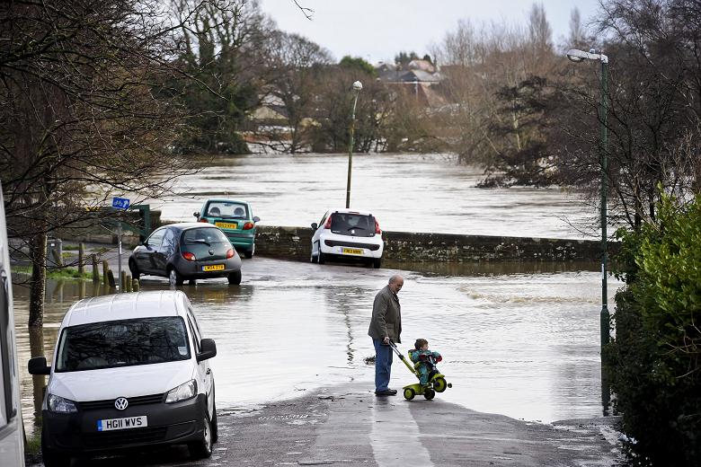
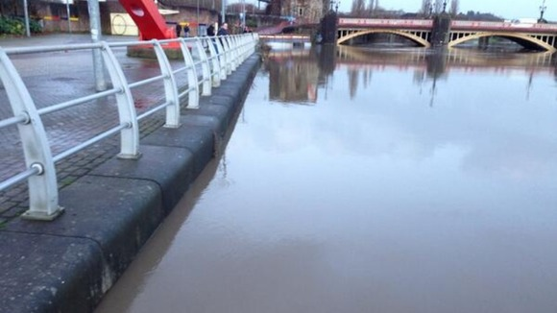

Slide 10
How would tributaries affect
a storm hydrograph?
A
B

Slide 11
Who would use hydrographs?
(and for what purpose?)

