Slide 1
The Stern Review
Commissioned by the UK Government 2005
A major economic study
Conclusion
***** is the greatest challenge facing humankind

Slide 2
IB Geography Core
Atmosphere & Change

Slide 3
Climate Change
What do we think we know?

Slide 4
Climate Change is an externality associated with greenhouse gas emissions.
It has costs for those who do not produce these emissions.
Strong immediate action can reduce the worst impacts
The economic cost of not acting would be larger than the cost associated with early responses.

Slide 5
Key Messages from the Stern Review (p142)
What is the potential rise in global temperature?
When will the greenhouse gas levels reach double their pre-industrial levels?
What could happen by 2100?
How might the impacts be magnified?
What could be the impacts to the water cycle?
What could happen if the Greenland or West Antarctic ice sheets melt?

Slide 6
Questions we need to consider…
How does the atmosphere function?
What affects the balance of our atmosphere?
What are the causes and consequences of global climate change?

Slide 7
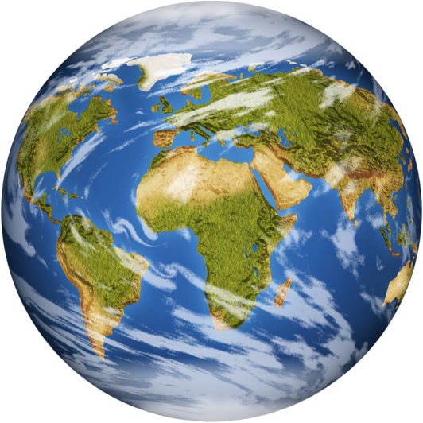
Atmospheric System
Energy
Energy
Albedo

Slide 8
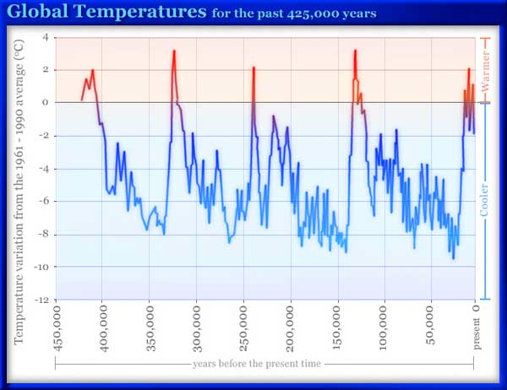

Slide 9
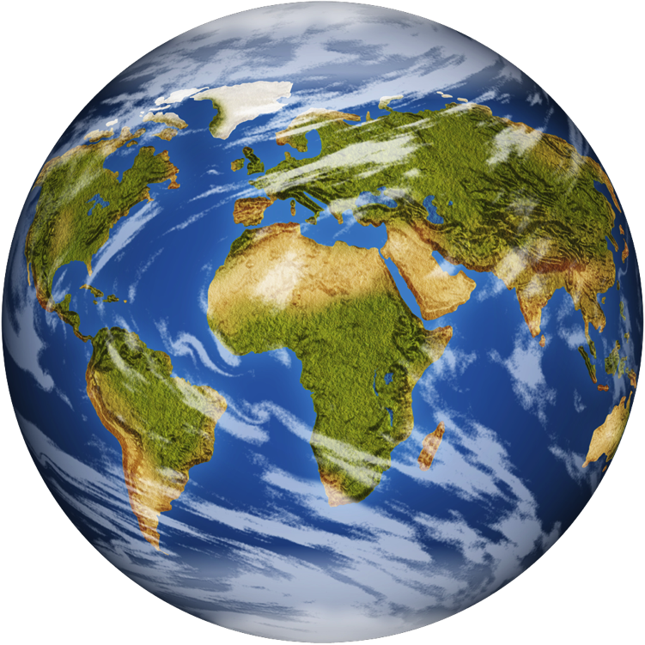
Curious?
ENERGY LOSS
Incomingsolarradiation
ENERGY INPUT
ENERGY LOSS

Slide 11
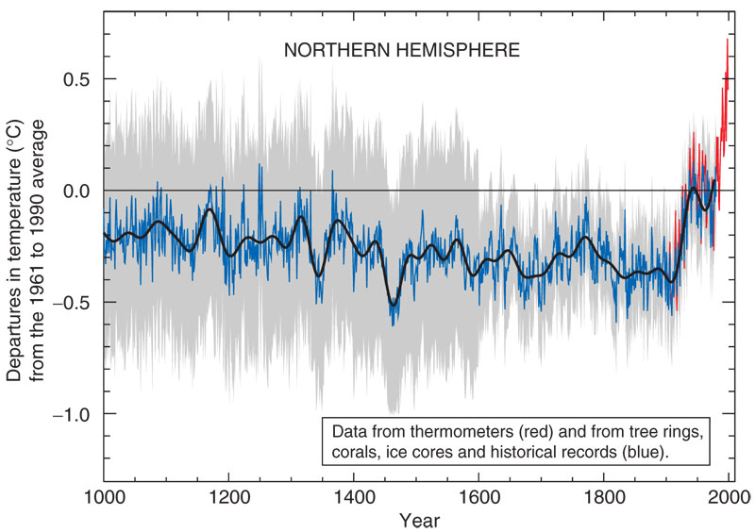

Slide 12
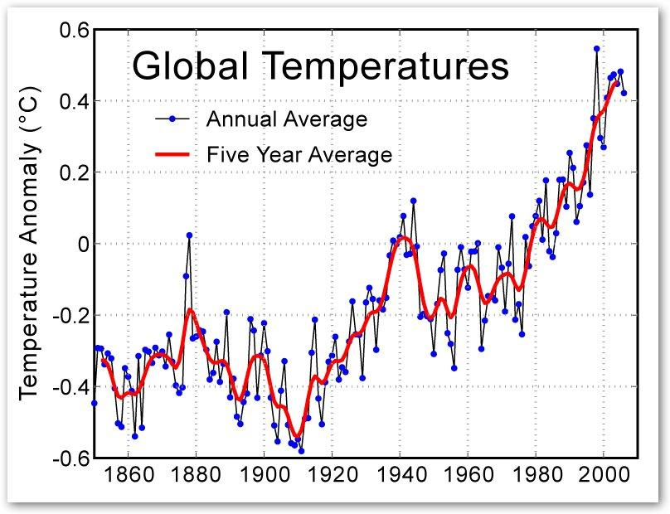

Slide 13
Changes in balance
Energy
Change in distance of earth orbit

Slide 14
Volcanic
eruptions
Change in ocean circulation

Slide 15
The Causes of Climate Change
Understanding Climate Change and the major contributors

Slide 16
Situation (yes I will give you a copy of the slides)
* The earth is getting warmer
* This is creating unexpected and severe changes to weather systems
* These recent changes show increasing potential to have damaging consequences to human populations in certain areas

Slide 17
Situation
* Global climate change is a natural and continuous occurrence
* The earth has been warmer and cooler than it is today
* Changes to energy from the sun, Earth orbit and the angle of Earth axis all produce climate change

Slide 18
Situation
* Large scale economic activity contributes to atmospheric pollution
* Human atmospheric pollution is now visual in many places
* The economic growth of large NIC’s like China and India has massively increased global Greenhouse gas emissions

Slide 19
Situation
* Current climate change is faster than any previous examples
* Human activity is responsible for this acceleration
* Predictions for 2100 are that the global temperature will rise between 1.6 and 4.2 degrees C

Slide 20
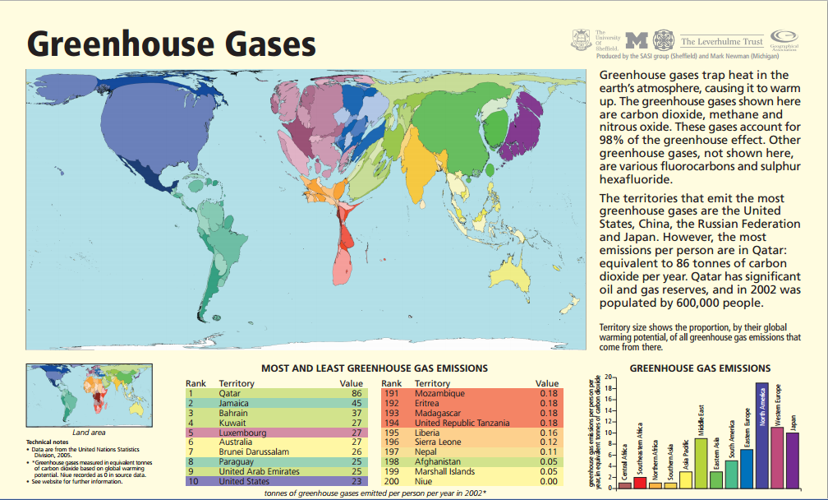

Slide 21
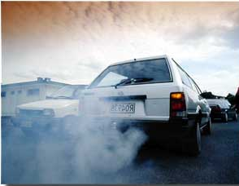
Carbon dioxide
Largest greenhouse gas
in atmospheric quantity
Produced by burning
fossil fuels (power,
factories, vehicles,
burning of forests,
domestic use)
Growth rate doubled in
2000-2010 compared to the 1990’s

Slide 22
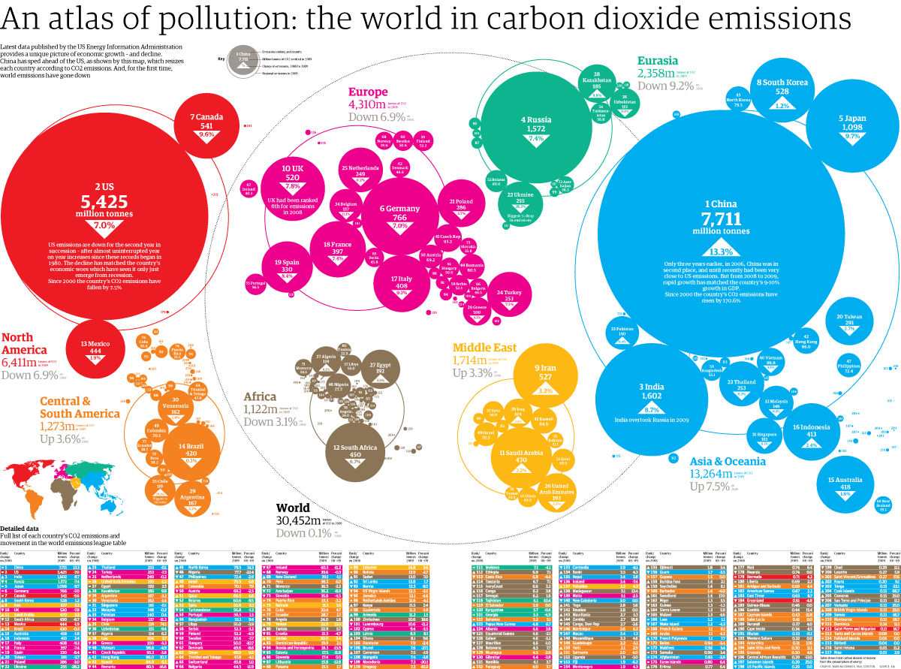

Slide 23
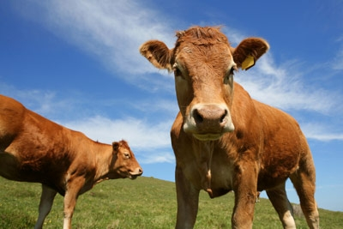
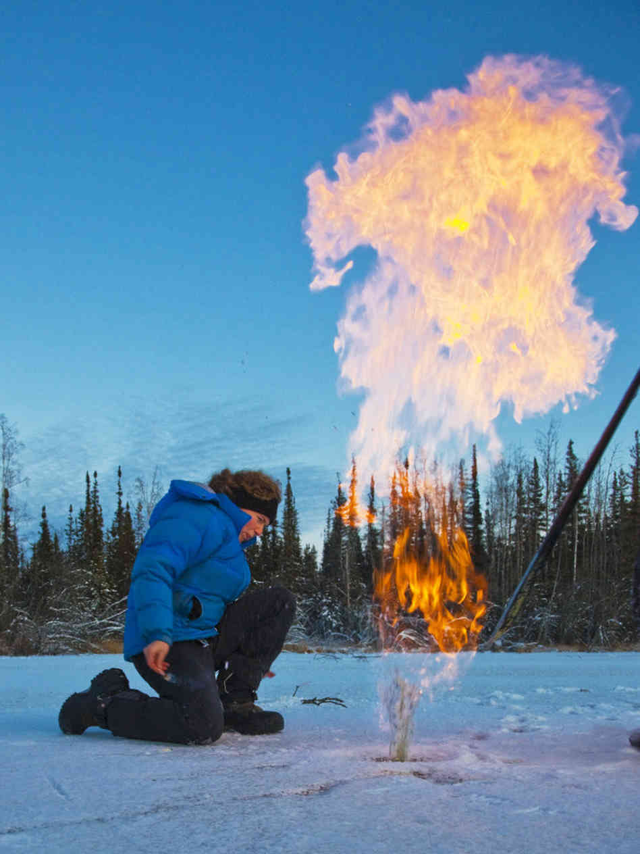
Methane
Second most prevalent
greenhouse gas
Release from decaying plant
and animal remains (swamps, peat bogs,
landfill sites). Farming is a big contributor
(cattle and rice)
There are many bogs and former swamp
areas trapped under ice in permafrost and
Arctic areas which will release methane as
they melt.

Slide 24
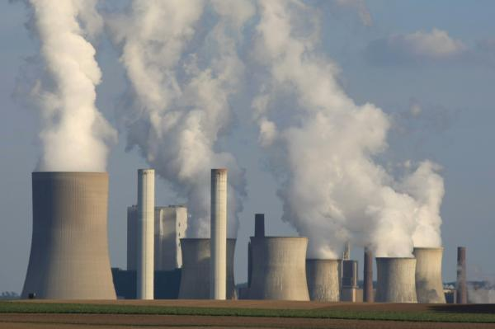
Nitrous Oxides
Nitrogen monoxide and Nitrogen dioxide
Another gas produced
From burning fossil
Fuels (mainly in power
Stations, cars ,
fertiliser and burning
Biomass.
Some success in
reducing vehicle
Emissions since the introduction of catalytic converters.

Slide 25
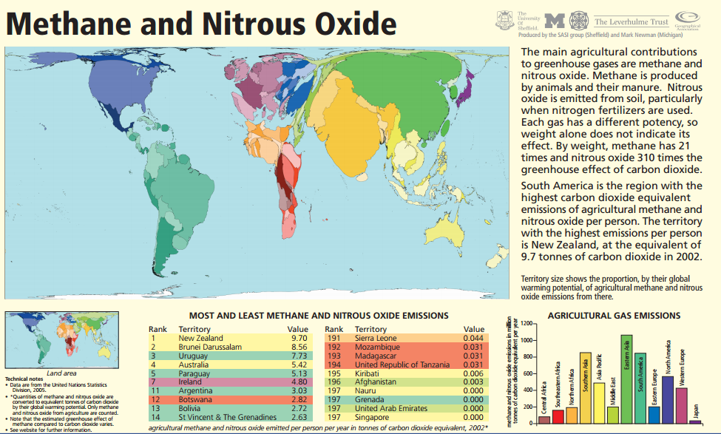

Slide 26
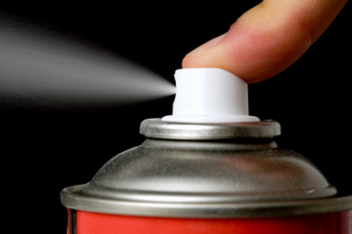
Chlorofluorocarbons
CFC’s are synthetic chemicals that destroy the ozone layer
Released from aerosols,
refrigerators, foam
packaging and AC’s
International control
agreements have reduce
the amount of CFC’s being
Released, but their lifetime
Is 20 – 100 years so those already released into the
Atmosphere will continue to damage for many years.

Slide 27
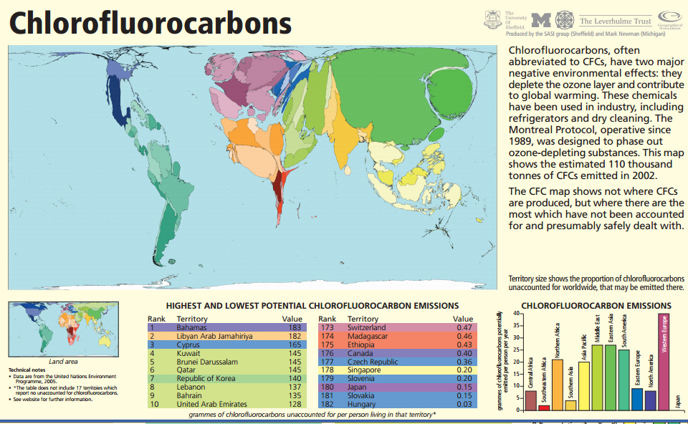

Slide 28
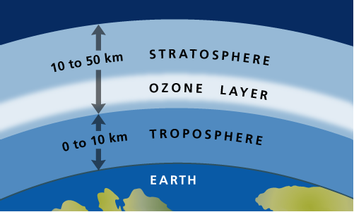
Ozone
Good Ozone: Stratospheric Ozone (Natural occurring) protects
the Earth from
ultraviolet light
Bad Ozone:
Trophospheric
Ozone (Human
produced) is a
result of air pollution.

Slide 29
Water Vapour
This is an example of positive feedback (which in this case is a bit of a negative for us!). Water vapour is not a pollutant,
but it is a greenhouse gas.
As the other greenhouse gasses work to increase the global temperature, the atmosphere becomes warmer
and more moist. Meaning it can hold more water
vapour. This positive feedback (one thing
increases because another increases) means that
water vapour can double any increases in
warming.
Water Vapour also creates more clouds which
can increase positive feedback by trapping in the
outgoing longwave radiation, this will increase temperatures even more. But it can also reduce temperature increase if clouds block insolation

Slide 30
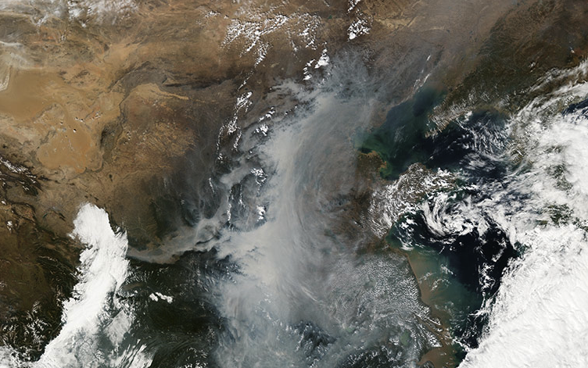

Slide 31
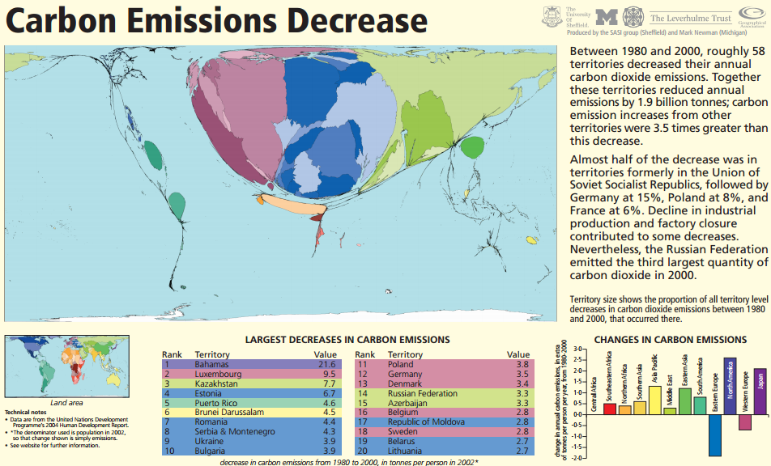

Slide 32
Questions
Carbon dioxide levels had been stable in the atmosphere at around 280ppm (parts per
million) for thousands of years. After 1860 this began rising and is currently in excess of
375ppm. What has caused this?
China is the largest producer of greenhouse
gases how could you argue that the USA has a
higher relative impact on the environment.
Which region of
the world has
been the most
successful in
limiting or
reducing carbon
Emissions
Draw a diagram to explain positive and negative feedback to global
temperature rise using water vapour as an example
China and the USA are the largest
producers of greenhouse gases,
identify 5 other significant
countries or regions
1)
2)
3)
4)
5)
I love Geo
Identify 3 major ways in
which humans
contribute greenhouse
gases to the
atmosphere.
1)
2)
3)
Why is relative CFC production so high in middle eastern countries?

Slide 33
The Consequences of Climate Change

Slide 34
Environmental Consequences
Use the text books as a framework for research (minimal research is needed, the main focus is
the thought process required for you to conceptualise the issue). Produce a diagrammatic
representation of your issue. You can produce a flow diagram, system diagram or any graphic
representation.
It MUST be only 1 page/screen maximum.
It should include some writing/annotation but text should not be the main component.
Concentrate on 1) What is the issue, 2) How does it happen 3) What are the impacts.
Use data
Avoid overlapping (e.g. melting ice caps + rising sea levels) so make sure you check the book to
find out the similar consequences and avoid repeating what someone else is working on.
You will present your completed image and explain it to the class.
Consequences are; Global temperature variations and heatwaves (Kelvin), Rising sea levels
(Jodie), Increasing acidity in oceans (Henry), Melting ice caps and glaciers (Nina), Thawing peat
Bogs (Bernhard), El Nino (Jasmine), Growth of the tropical belt (Shannon), Changing patterns of
Rainfall (Sion), Declining crop yields (Diego), Impact on wildlife (Henry)

Slide 35
Responses to Climate Change

Slide 36
2 way response
Reduce the causes
of greenhouse gas
emissions
Prepare for the consequences of significant climate change
Sustainability

Slide 37
Government Legislation
Other ideas include;
Significant investment in new public transport systems
Converting more public transport systems to electric
Halt airport expansion
UK intends to be the first country to set legally binding targets in order to reduce Co2 emissions by 60% by 2050
Achieved through 5 year carbon budgets
And…

Slide 38
Community Energy
Small scale electrical generation units (for example wind turbines and solar panels) in new building developments
Reduce inefficiency – a lot of energy is lost through transmission

Slide 39
Glossary Challenge
The property of the Earth’s atmosphere by which long wavelength heat rays from the earths surface are trapped or reflected back by the atmosphere
Results from human activities which increase the concentration of naturally occurring greenhouse gases and leads to global warming and climate change
A worldwide decline of the intensity of the sunlight reaching the Earth’s surface, caused by particulate air pollution and natural events (e.g. volcanic ash)
The increase in the average temperature of the Earth’s near surface air in the 20th and early 21st Centuries and its projected continuation
Long term sustained change in the average global climate
An increasing amount of sunlight reaching the Earth’s surface, caused by an intensification of solar radiation
The heat energy from the sun consisting of the visible spectrum together with ultraviolet and infrared rays
A thick layer of ice covering extensive regions of the world, notably Antarctica and Greenland
The point at which the damage caused to global systems by climate change becomes irreversible
Energy produced close to the point of consumption to avoid loss during transmission
The balance between incoming solar radiation and outgoing solar radiation
The proportion of surface radiation that is reflected by a particular body or surface
Human produced ozone, a result of air pollution in the lowest layer of the atmosphere
The transfer of heat by the movement of a gas or a liquid
When an increase in one phenomenon results in the increase of another.
Change in state from liquid into vapour
The transfer of heat by contact
Change in state from gas to a liquid

Slide 40
Glossary Challenge - Answers
Results from human activities which increase the concentration of naturally occurring greenhouse gases and leads to global warming and climate change – Enhanced greenhouse effect
A worldwide decline of the intensity of the sunlight reaching the Earth’s surface, caused by particulate air pollution and natural events (e.g. volcanic ash) – Global dimming
The increase in the average temperature of the Earth’s near surface air in the 20th and early 21st Centuries and its projected continuation Global warming
A thick layer of ice covering extensive regions of the world, notably Antarctica and Greenland - Ice Sheet
Long term sustained change in the average global climate – Climate Change
The property of the Earth’s atmosphere by which long wavelength heat rays from the earths surface are trapped or reflected back by the atmosphere – Natural greenhouse effect
The heat energy from the sun consisting of the visible spectrum together with ultraviolet and infrared rays – Insolation
Energy produced close to the point of consumption to avoid loss during transmission – Community Energy
An increasing amount of sunlight reaching the Earth’s surface, caused by an intensification of solar radiation – Global brightening
Human produced ozone, a result of air pollution in the lowest layer of the atmosphere – Tropospheric Ozone
The proportion of surface radiation that is reflected by a particular body or surface – Albedo
The transfer of heat by the movement of a gas or a liquid – Convection
The point at which the damage caused to global systems by climate change becomes irreversible – Tipping point
The balance between incoming solar radiation and outgoing solar radiation – Energy balance
When an increase in one phenomenon results in the increase of another – Positive feedback
Change in state from gas to a liquid – Condensation
The transfer of heat by contact – Conduction
Change in state from liquid into vapour – Evaporation

Slide 41
 | Answer
1
2
3
4
5
6
7
8
9
10
11
12
13
14
15
16
17
18
 | Answer
1
2
3
4
5
6
7
8
9
10
11
12
13
14
15
16
17
18

