Slide 1
Leisure, Sport
and Tourism

Slide 2
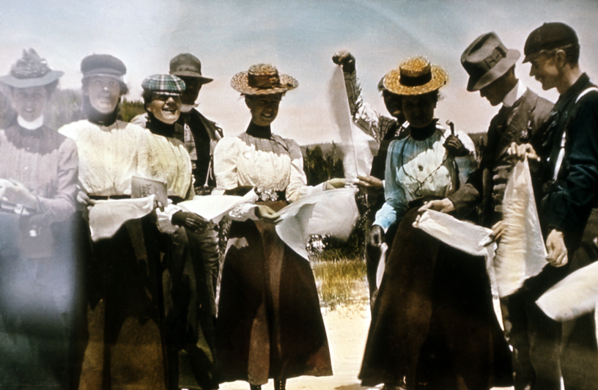
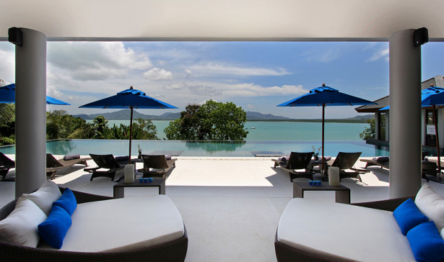
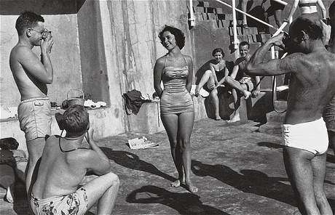
Leisure, Sport and Tourism
What is Leisure and tourism and how have they changed in the last 60 years?

Slide 3
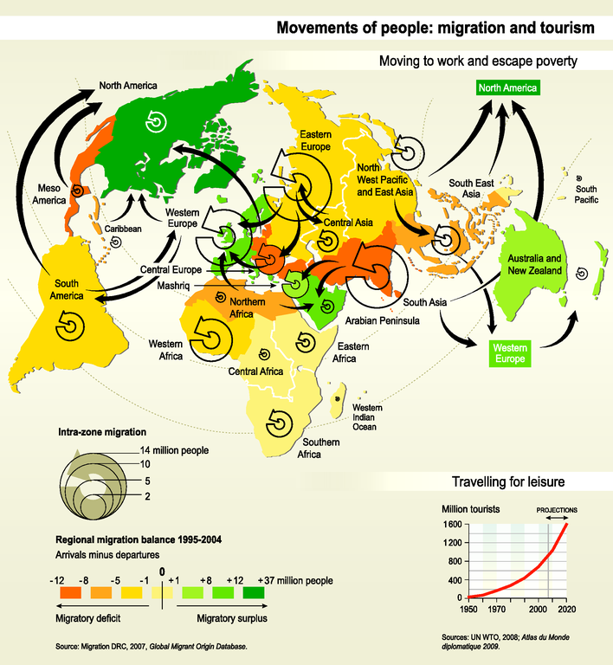
Leisure, Sport and Tourism
Supply & Demand. Where do tourists come from and where do they go?

Slide 4
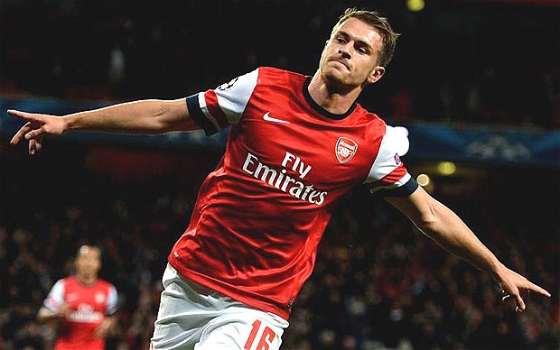
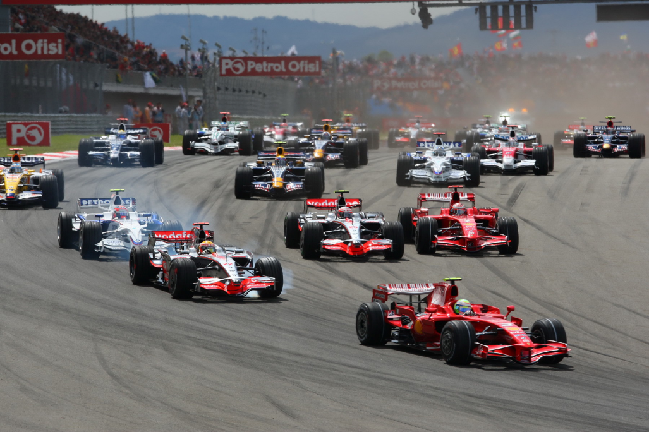
Leisure, Sport and Tourism
Examine 2 global sports

Slide 5
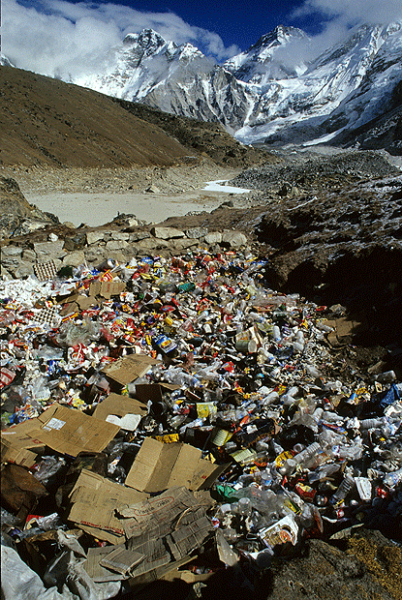
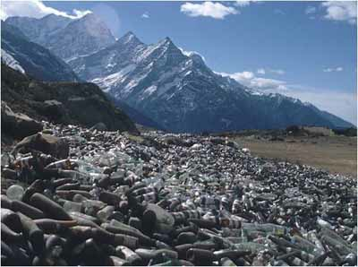
Leisure, Sport and Tourism
Impacts of tourism

Slide 6
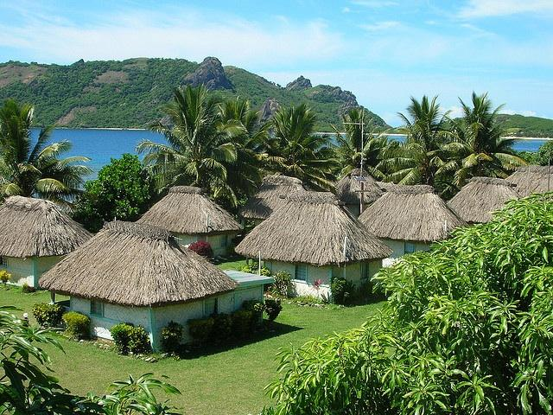
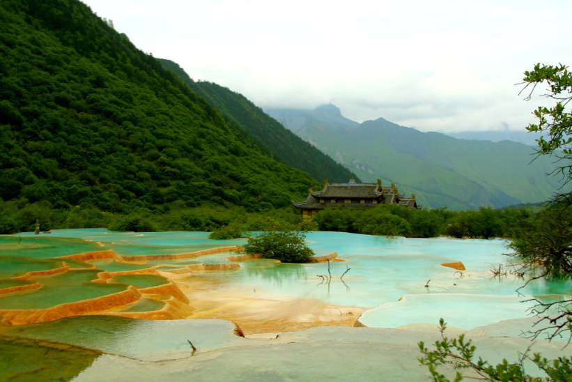
Leisure, Sport and Tourism
Sustainability
in Leisure and Tourism

