Slide 1
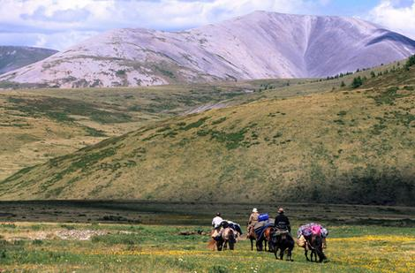
Case Study Low population density- Mongolia
Full of geographic and climatic extremes.
Mountainous and arid, [Gobi Desert] = less suitable land for farms and settlements.
Winters are long and temperatures extreme.
Remote with poor communications – trade and job opportunities are limited- people move away.

Slide 2
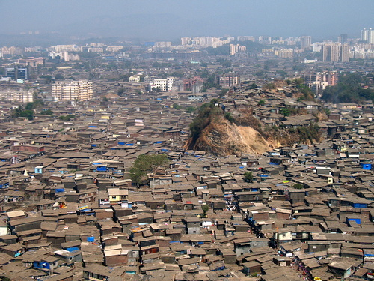
Case Study high population density- Mumbai, India
On the Arabian Sea coast= cool sea breezes
Good water supply
Mumbai is India’s largest port handling 30% of India's exports and imports.
It is India's banking and finance capital and has a huge industrial sector accounting for 20% of India's total employment in industry- people move in.

