Slide 1
Hazards & Disasters, Risk & Response

Slide 2
Types of Hazard
Erosion
Droughts
Fires
C, H, T
Tsunami
Floods
Frost
Hail
Heatwave
Infestation
Snow & Ice
Lightning
Tornadoes
Landslides
Earthquake
Avalanche
Shifting sand
Fungal diseases
Volcanic eruption
Poisonous plants
Bacterial & viral diseases
Venomous Animal Bites

Slide 3
4 Studies
of different Hazards

Slide 4
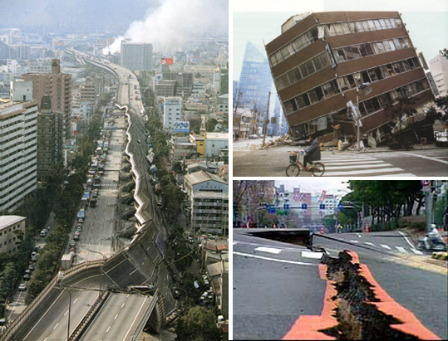
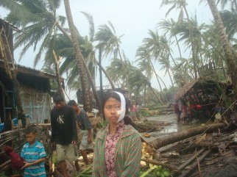
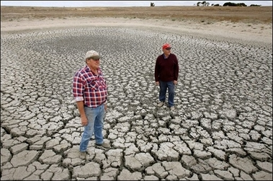

Slide 5
Characteristics
Where, Why, How
When, how often, duration, speed, length of effect

Slide 6
Vulnerability
Demographics, socio-economics, preparedness, ability to react

Slide 7
Risk and Risk Assessment
Risk vs Probability, predicted loss, preparedness, risk perception, probability

Slide 8
Disasters
Hazard vs disaster, measuring spatial extent and intensity, cuase and impact of natural and human disasters, how impacts have changed over time

Slide 9
Adjustment and Response
Assessing risk for strategies and response, spreading risk and land use planning, damage limitation

Slide 10
Fieldwork

