Slide 1
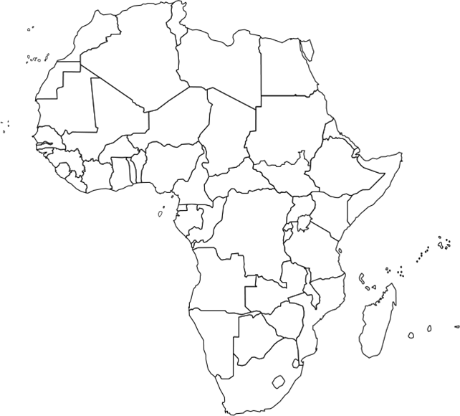
Africa - High Fertility Rates

